Slide 1
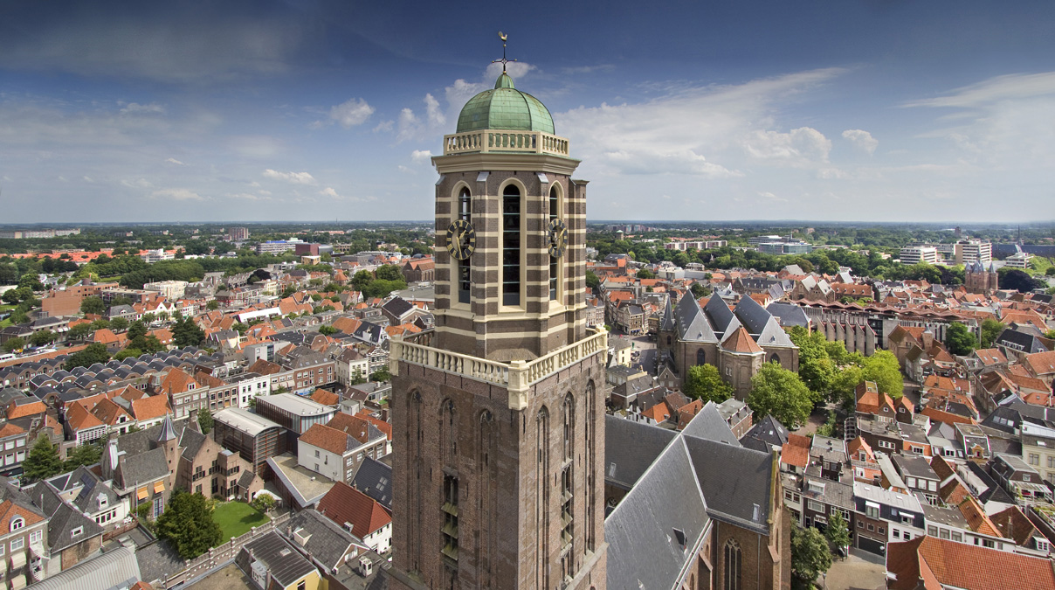
The history of Zwolle

Slide 2
What will be in this lesson?
Learning question and learning goals
A short history of Zwolle
Preparation for the tour through Old Town

Slide 3
Learning question and learning goals
In this lesson series we will work with the learning question: What do you know about the city of Zwolle?
The learning goals connected to that are:
Students can create a presentation according to the presentation guide.
Students can name at least five historical buildings of Zwolle and can tell the stories linked to them.

Slide 4
A short history of Zwolle
Tour through Old Town

Slide 5
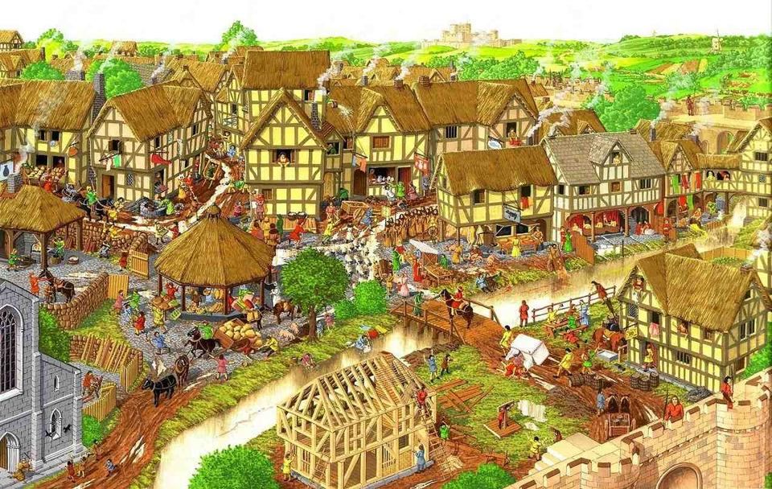
The first habitants of Zwolle
In the early Middle Ages some people settled on the banks inbetween the rivers Vecht and IJssel.
The rise of land was called ‘suolle’. That name turned into the name of Zwolle and the city was born.

Slide 6
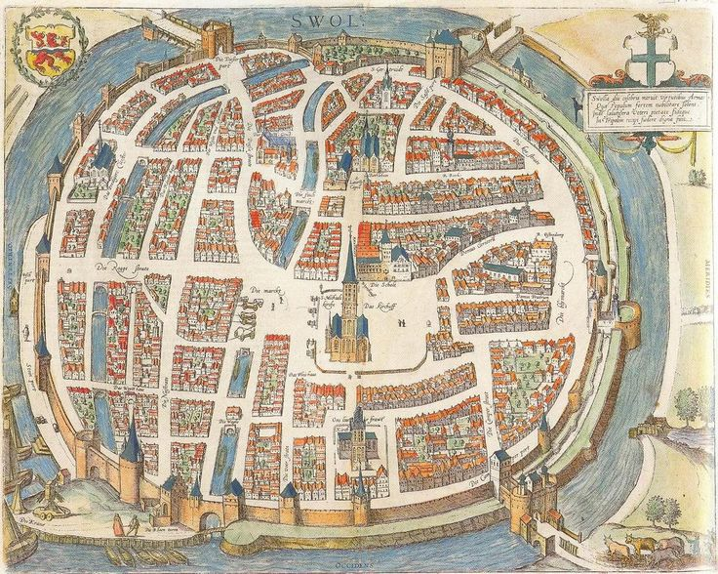
Middle Ages
Around the year 1000 the city was first mentioned in documents. The city slowly grow. In 1230 the city got its cityright.
The city played an important part in the Modern Devotion. Thomas a Kempis originates from the city.

Slide 7
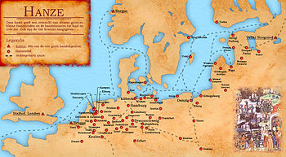
Member of the Hanze trade Union
In the early 15th century the city became a member of the Hanze.
The city gained more and more independence. The 15th centery were the highdays of the city.

Slide 8
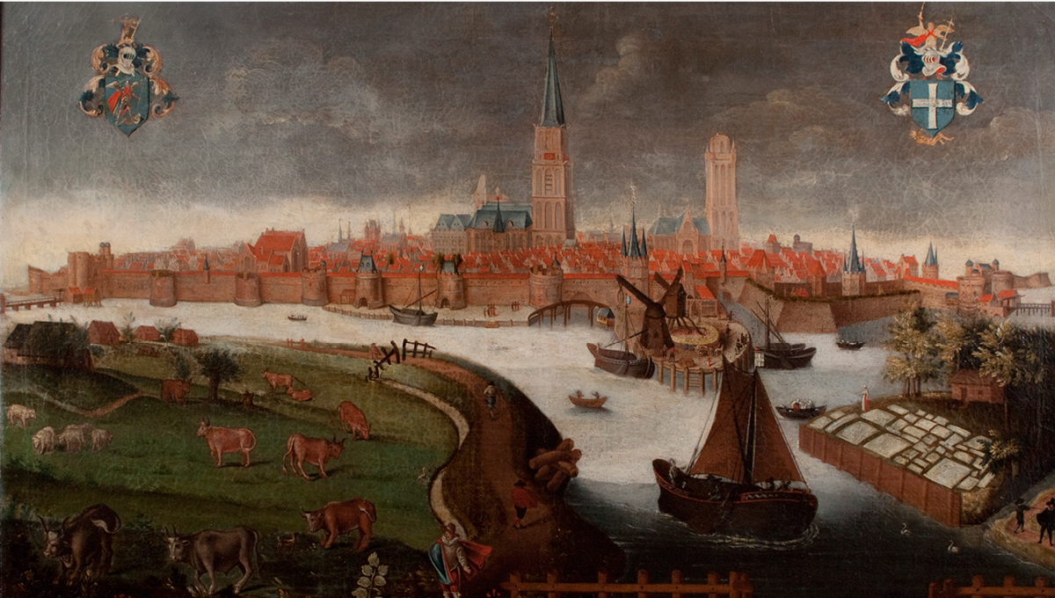
Troubled times
In the early 16th century a tradingwar with the rivaling city of Kampen started.
The duke of Gelre besieged the city. But the city tricked the duke in getting into the city and made him a prisoner.
The nickname ‘bluefingers’ originates from the conflict with Kampen. The city of Kampen had a debt to city of Zwolle. They payed this debt in nickles. The clerks of Zwolle got blue fingers from counting all those nickles.

Slide 9
The Dutch war of independence
In the middle of the 16th century there was a lot of conflict in the Netherlands between portestants and catholics. A lot of wars broke out and a lot of catholic religious places where destroyed. But not in Zwolle. There was a protestant majority but they were very tolerant to eachother.
A war for Dutch independence broke out. The city was doubtful in choosing a side. So during the war the city changed sides a couple of times. But eventually they supported the uprising against the Spaniards. This resulteds in some battles for and even inside the city. Eventually the Netherlands gained their independence.

Slide 10
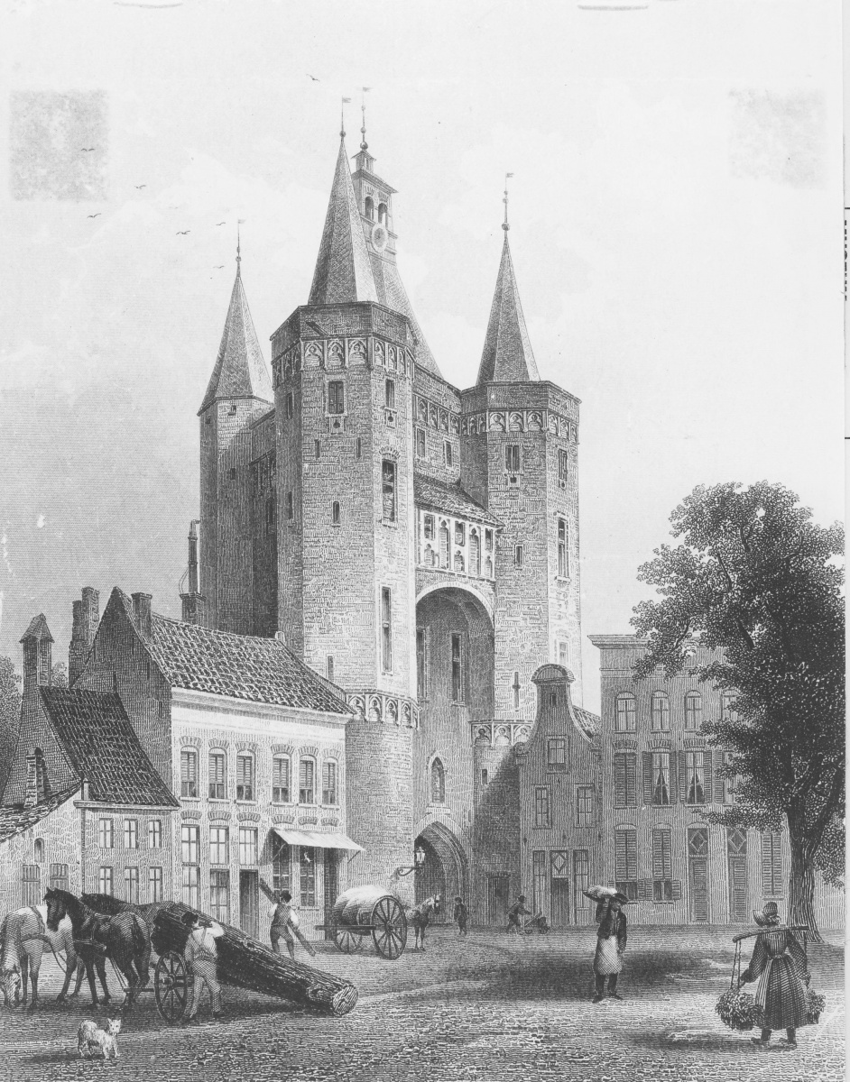
Peacefull times
After that Zwolle was peacefull for a long time.
After the French occupation Zwolle became the capital of the province Overijssel.
The city grow slowly. After the industrial revolution the city got its own railwaystation. The city already expanded outside the city walls.

Slide 11
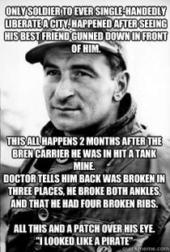
World War II
During World War II the city was occupied by the Germans. Because the city was the province capital a lot of German institutes were placed in the city.
At the end of the war the city got liberated by the Canadians. This is an heroic story because just one man, Leo Major, liberated the city by himself.

Slide 12
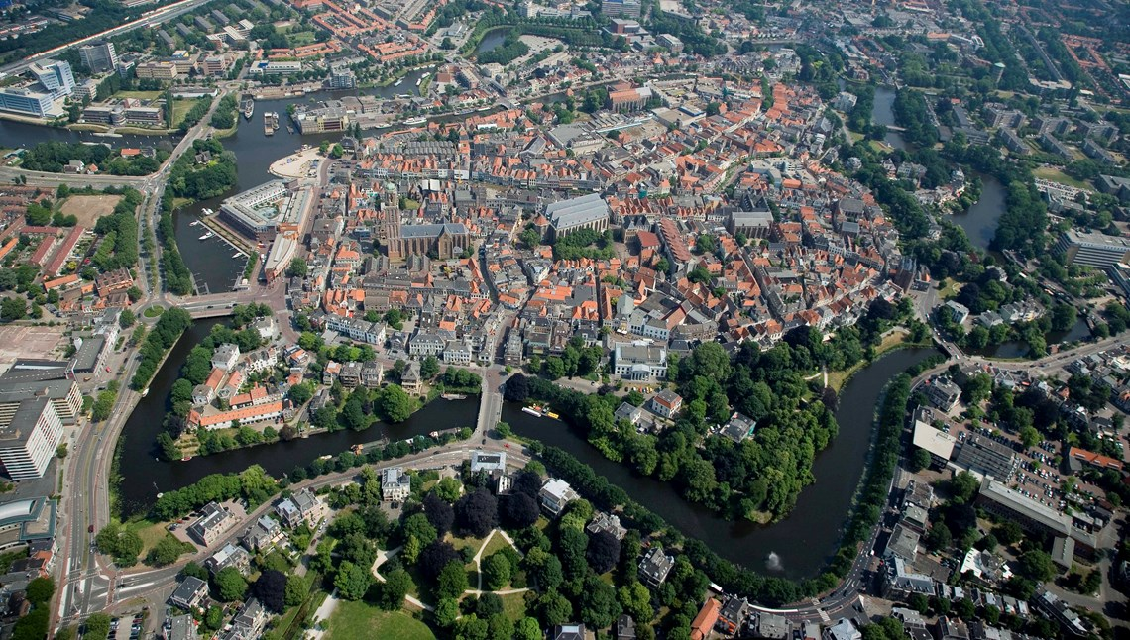
Nowadays
After the war the city grew even more. Nowadays the city is one of the most prosperous cities in the Netherlands.

Slide 13
The city tour
The assignment contains two parts
The first part is a tour through the Old Town of Zwolle by doing a puzzle.
In the second part you will give a presentation about a specific topic in Zwolle.
There will be five different groups.
The presentation will take place in lesson three and four.

Slide 14
Assignment
Go to: https://maken.wikiwijs.nl/117621/City_tour_Old_Town_Zwolle
On this webpage you can find all the information you need
Let’s make groups.
Look at the webpage with your group and start preparing for the assignment.
Are there any questions?

Slide 15
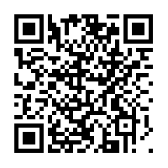
Scan the QR-code

